Slide 1
FAQ:
Q. How do I reset the links on the main board back to yellow?
A. Simply close the PowerPoint file, and re-open, and the links will turn back to yellow.
Q. Can I use this in Keynote / Google Slides / Open Office?
A. Sorry, but Google slides, Keynote, Open Office etc. are not supported. Those are great programs but they’re not made to handle a file with this animation complexity.
Q. Why aren’t the sound effects working?
A. If the sound effects aren’t working, I would suggest upgrading your PowerPoint to something newer than 2008, and using a PC instead of a Mac if possible. Also, Google slides, Keynotes, etc. are not supported.
Q. Can I get a board with less categories? Can I add a custom logo?
A. Unfortunately these changes are a little too complex for me to explain or assist you via email, but if you’d like me to do a custom job for you for a small fee, send me an email at Reid@youthdownloads.com. You can also try using an App I made called TriviaMaker which lets you easily create Jeopardy style games and customize the number of categories, colors and logo at www.TriviaMaker.com
Q. Is there a tutorial I can watch to edit / play this game?
Yes. To see it in action, or learn how to make edits, watch this video: https://youtu.be/tDC1mXh9NPE
Q. How can I replace the categories quickly?
Use Ctrl F for the following
OLD TESTAMENT KNOWLEDGE = Category 1
GENERAL BIBLE TRIVIA = Category 2
CAT1Q1 = Category1 Question 1
CAT1A1 = Answer for cat1Q1
FinalJepCAT = Final Jeopardy Category
FinalJepQ - FInal Jepardy Question
FinalJepA = Final Jepardy Answer
Notes:
Family Feud Template
Introduction Slide – Family Feud!

Slide 2


JEOPARODY JEOPARODY JEOPARODY JEOPARODY JEOPARODY JEOPARODY JEOPARODY JEOPARODY JEOPARODY JEOPARODY JEOPARODY JEOPARODY JEOPARODY JEOPARODY JEOPARODY JEOPARODY JEOPARODY JEOPARODY JEOPARODY
JEOPARODY JEOPARODY JEOPARODY JEOPARODY JEOPARODY JEOPARODY JEOPARODY JEOPARODY JEOPARODY JEOPARODY JEOPARODY JEOPARODY JEOPARODY JEOPARODY JEOPARODY JEOPARODY JEOPARODY JEOPARODY JEOPARODY

Slide 3
HERE ARE TODAY’S CATEGORIES

Slide 4

OLD TESTAMENT KNOWLEDGE

Slide 5
GENERAL BIBLE TRIVIA

Slide 6
HEBREW WORDS

Slide 7
FAITH VERSES

Slide 8
COMPLETE THE PROVERB

Slide 9
NEW TESTAMENT KNOWLEDGE

Slide 10

OLD TESTAMENT KNOWLEDGE
GENERAL BIBLE TRIVIA
HEBREW WORDS
FAITH VERSES
COMPLETE THE PROVERB
NEW TESTAMENT KNOWLEDGE
$100
$100
$100
$100
$100
$100
$200
$200
$200
$200
$200
$200
$300
$300
$300
$300
$300
$300
$400
$400
$400
$400
$400
$400
$500
$500
$500
$500
$500
$500
FINAL JEOPARODY

Slide 11
$100 Question from Category: OLD TESTAMENT KNOWLEDGE
Before Sin where did Adam and Eve live?

Slide 12
$100 Answer from Category: OLD TESTAMENT KNOWLEDGE
The Garden of Eden

Slide 13
$200 Question from Category: OLD TESTAMENT KNOWLEDGE
LEVITICUS 20:24
God promised the Israelites a land flowing with milk and _______________

Slide 14
$200 Answer from
OLD TESTAMENT KNOWLEDGE
Honey

Slide 15
$300 Question from Category:
OLD TESTAMENT KNOWLEDGE
GENESIS 37: 5-9
Who dreamed that the sun and the moon and 11 stars bowed down to him?

Slide 16
$300 Answer from Category:
OLD TESTAMENT KNOWLEDGE
Joseph

Slide 17
$400 Question from Category:
OLD TESTAMENT KNOWLEDGE
GENESIS 8:8-12
How many times did Noah send out a dove from the ark?

Slide 18
$400 Answer from Category:
OLD TESTAMENT KNOWLEDGE
Three times

Slide 19
$500 Question from Category:
OLD TESTAMENT KNOWLEDGE
ECCLESIASTES 12:13
What is the whole duty of man?

Slide 20
$500 Answer from Category:
OLD TESTAMENT KNOWLEDGE
Fear God and keep his commandments

Slide 21
$100 Question from
Category: GENERAL BIBLE TRIVIA
Who is the second most mentioned man in the Bible?

Slide 22
Answer $100
Category: GENERAL BIBLE TRIVIA
Kind David
He is mentioned 1,118 times in the Bible, making him the second most mentioned man behind only Jesus.

Slide 23
$200 Question from
Category: GENERAL BIBLE TRIVIA
What is the longest book in the Bible?

Slide 24
$200 Answer
Category: GENERAL BIBLE TRIVIA
Psalms (150 chapters)

Slide 25
$300 Question from
Category: GENERAL BIBLE TRIVIA
How many books in the bible are not divided into chapters

Slide 26
$300 Answer
Category: GENERAL BIBLE TRIVIA
Five
Obadiah, Philemon, 2 John, 3 John, and Jude.

Slide 27
$400 Question from
Category: GENERAL BIBLE TRIVIA
1 KINGS 6:1
Who built the temple in Israel?

Slide 28
$400 Answer from
Category: GENERAL BIBLE TRIVIA
King Solomon

Slide 29
$500 Question from
Category: GENERAL BIBLE TRIVIA
Only book in the bible that does not mention God

Slide 30
$500 Answer from
Category: GENERAL BIBLE TRIVIA
Esther

Slide 31
$100 Question from
Category: HEBREW WORDS
SHALOM

Slide 32
$100 Question from
Category: HEBREW WORDS
Peace, completeness

Slide 33
$200 Question from
Category: HEBREW WORDS
SHALEM

Slide 34
$200 Answer from
Category: HEBREW WORDS
Whole heartedly

Slide 35
$300 Question from
Category: HEBREW WORDS
SHEMA

Slide 36
$300 Answer from
Category: HEBREW WORDS
to hear, Obey

Slide 37
$400 Question from
Category: HEBREW WORDS
MAAN

Slide 38
$400 Answer from
Category: HEBREW WORDS
Purpose, reason

Slide 39
$500 Question from
Category: HEBREW WORDS
AYIN TOVAH

Slide 40
$500 Answer from
Category: HEBREW WORDS
A Good Eye

Slide 41
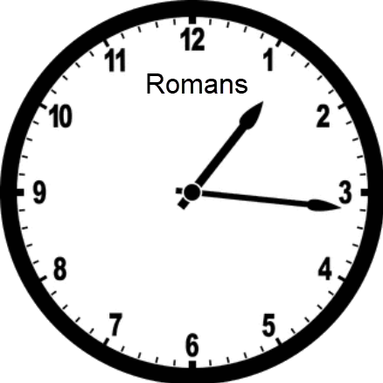
$100 Question from
Category: FAITH VERSES

Slide 42
$100 Answer from
Category: FAITH VERSES
For I am not ashamed of the gospel, for it is the power of God for salvation to everyone who believes,
Romans 1:16 (ESV)

Slide 43

$200 Question from
Category: FAITH VERSES

Slide 44
$200 Answer from
Category: FAITH VERSES
For the grace of God has appeared, bringing salvation for all people,
Titus 2:11(ESV)

Slide 45
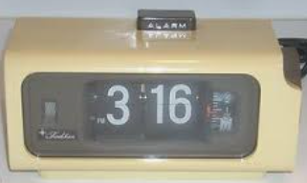
$300 Question from
Category: FAITH VERSES
JOHN

Slide 46
$300 Answer from
Category: FAITH VERSES
For God so loved the world, that he gave his only Son, that whoever believes in him should not perish but have eternal life.
John 3:16 (ESV)

Slide 47
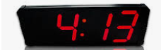
$400 Question from
Category: FAITH VERSES
Source Cat4Q4
Philippians

Slide 48
$400 Answer from
Category: FAITH VERSES
I can do all things through him who strengthens me.
Philippians 4:13(ESV)

Slide 49
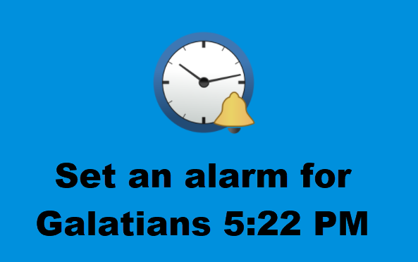
$500 Question from
Category: FAITH VERSES

Slide 50
$500 Answer from
Category: FAITH VERSES
But the fruit of the Spirit is love, joy, peace, patience, kindness, goodness, faithfulness, gentleness, self-control;
Galatians 5:22-23 (ESV)

Slide 51
$100 Question from
Category: COMPLETE THE PROVERB
Proverbs 9:10
The fear of the Lord is the beginning of ______ and the knowledge of the Holy One is insight.

Slide 52
$100 Answer from
Category: COMPLETE THE PROVERB
The fear of the Lord is the beginning of wisdom, and the knowledge of the Holy One is insight.
Proverbs 9:10 (ESV)

Slide 53
$200 Question from
Category: COMPLETE THE PROVERB
Be not wise in your own _____; fear the Lord, and turn away from evil.
Proverbs 3:7 (ESV)

Slide 54
$200 Answer from
Category: COMPLETE THE PROVERB
Be not wise in your own eyes; fear the Lord, and turn away from evil.
Proverbs 3:7 (ESV)

Slide 55
$300 Question from
Category: COMPLETE THE PROVERB
A wise son hears his father’s instruction, but a scoffer does not _______ to rebuke.
Proverbs 13:1 (ESV)

Slide 56
$300 Answer from
Category: COMPLETE THE PROVERB
A wise son hears his father’s instruction, but a scoffer does not listen to rebuke.
Proverbs 3:7 (ESV)

Slide 57
$400 Question from
Category: COMPLETE THE PROVERB
but he who fails to find me injures himself; all who hate me love ______.
Proverbs 8:36 (ESV)

Slide 58
$400 Answer from
Category: COMPLETE THE PROVERB
but he who fails to find me injures himself; all who hate me love death.
Proverbs 8:36 (ESV)

Slide 59
$500 Question from
Category: COMPLETE THE PROVERB
Whoever gets sense loves his own _____; he who keeps understanding will discover good
Proverbs 19:8 (ESV)

Slide 60
$500 Answer from Category: COMPLETE THE PROVERB
Whoever gets sense loves his own soul; he who keeps understanding will discover good
Proverbs 19:8 (ESV)

Slide 61
$100 Question from
Category: NEW TESTAMENT KNOWLEDGE
Which type of stories did Jesus use to teach his disciples?

Slide 62
$100 Answer from
Category: NEW TESTAMENT KNOWLEDGE
Parables

Slide 63
$200 Question from
Category: NEW TESTAMENT KNOWLEDGE
ACTS 28:1-5
What bit Paul while he was shipwrecked on the island of Malta?

Slide 64
$200 Answer from
Category: NEW TESTAMENT KNOWLEDGE
a Snake

Slide 65
$300 Question from
Category: NEW TESTAMENT KNOWLEDGE
ACTS 2:1-4
On what day did the Holy Spirit descend on the apostles in the form of tongues of fire?

Slide 66
$300 Answer from
Category: NEW TESTAMENT KNOWLEDGE
The Day of Pentecost

Slide 67
$400 Question from
Category: NEW TESTAMENT KNOWLEDGE
MARK 6:22-25
Who asked for John the Baptist's head on a platter?

Slide 68
$400 Answer from
Category: NEW TESTAMENT KNOWLEDGE
Salome

Slide 69
$500 Question from
Category: NEW TESTAMENT KNOWLEDGE
Of the 27 books in the New Testament, how many have been attributed to the Apostle Paul?

Slide 70
$500 Answer from
Category: NEW TESTAMENT KNOWLEDGE
Fourteen

Slide 71


Slide 72
Category: Bible Analytics
How many total books are in the bible?
GO TO
PROMPT
(RESPONSE)
Start Timer

Slide 73
66 Total books
39 Old testament & 27 New testament

